Slide 1
www.luminmusic.com

Slide 2
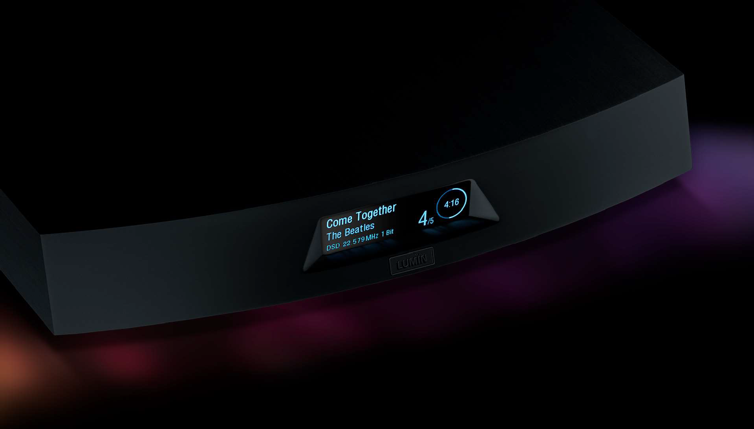
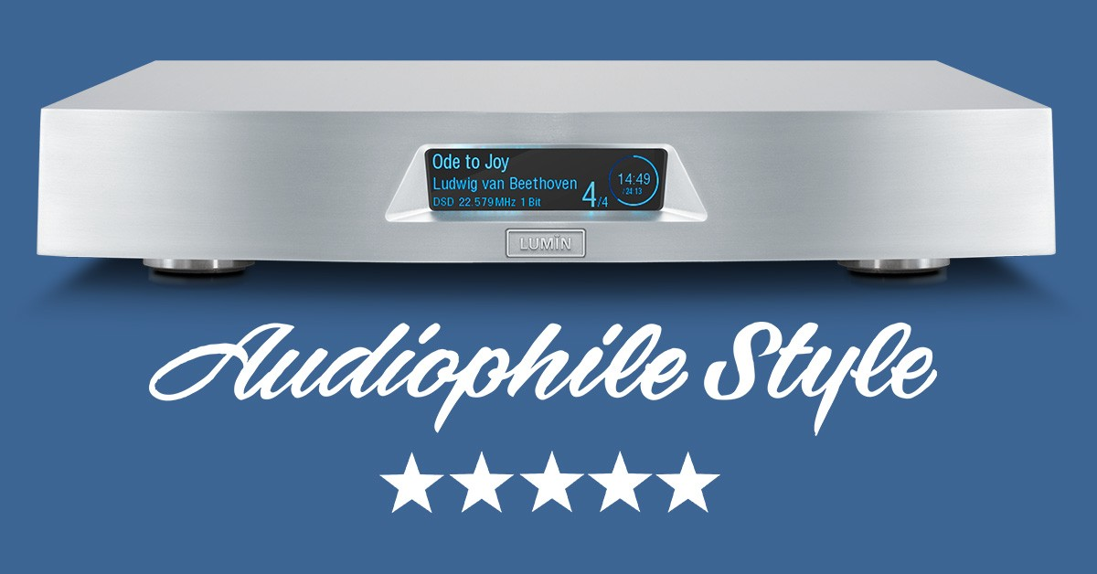

Slide 3
Lvmin XI & AmP

Slide 4
Multi Room

Slide 7
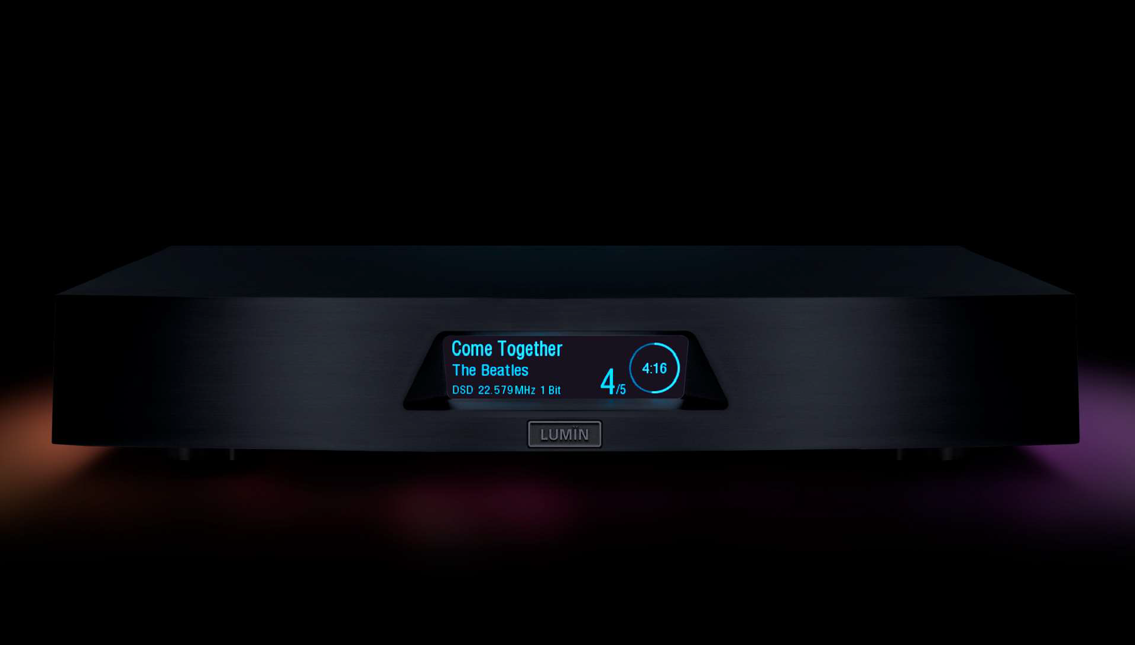
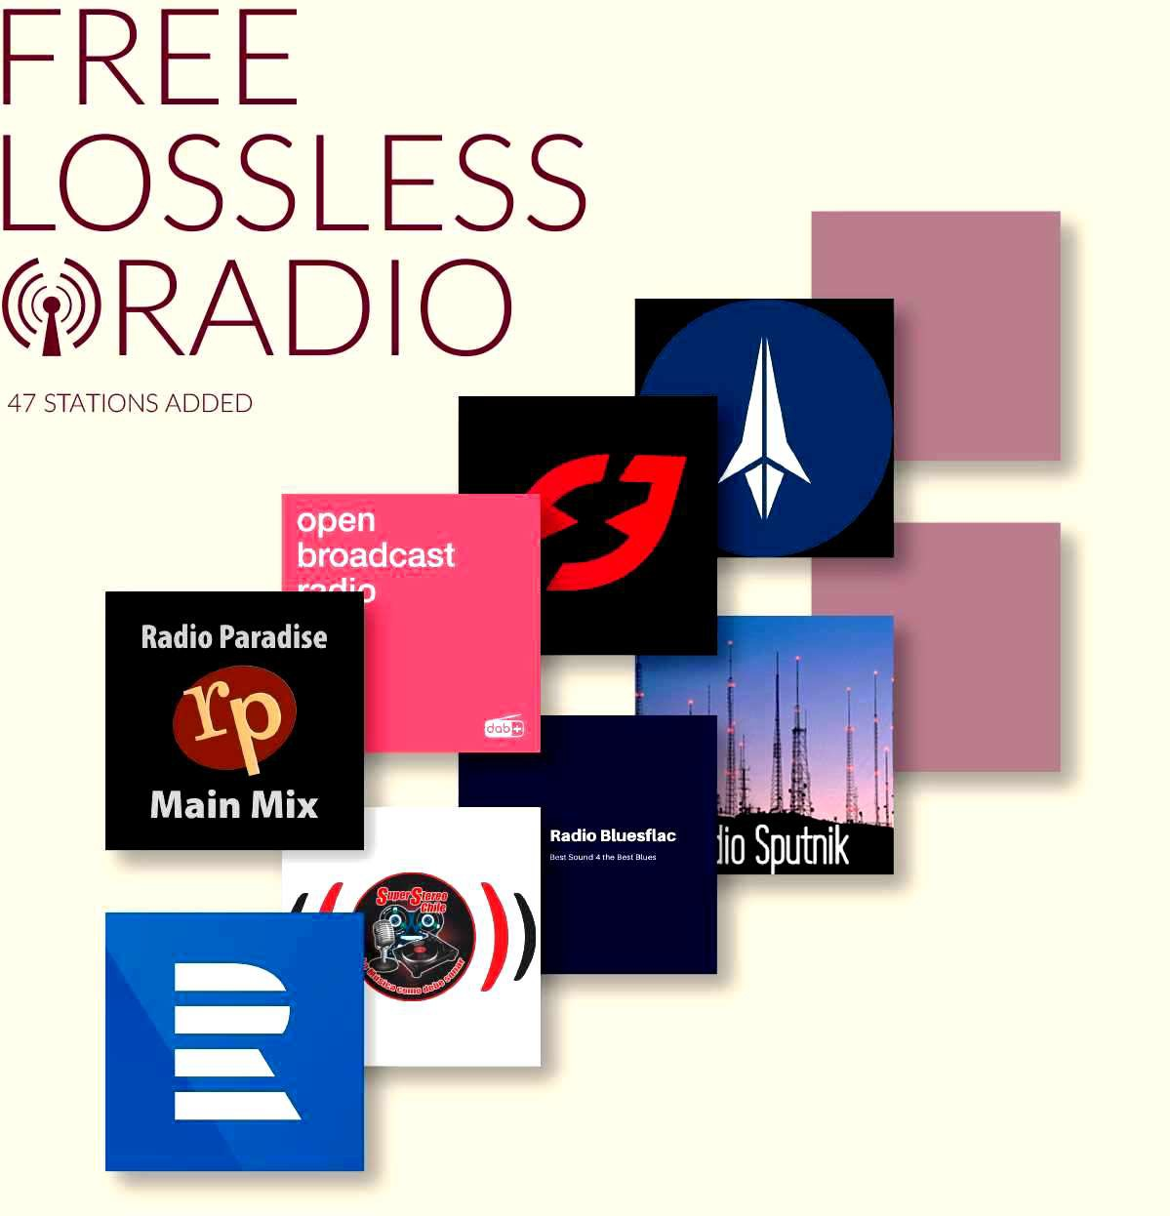

Slide 8
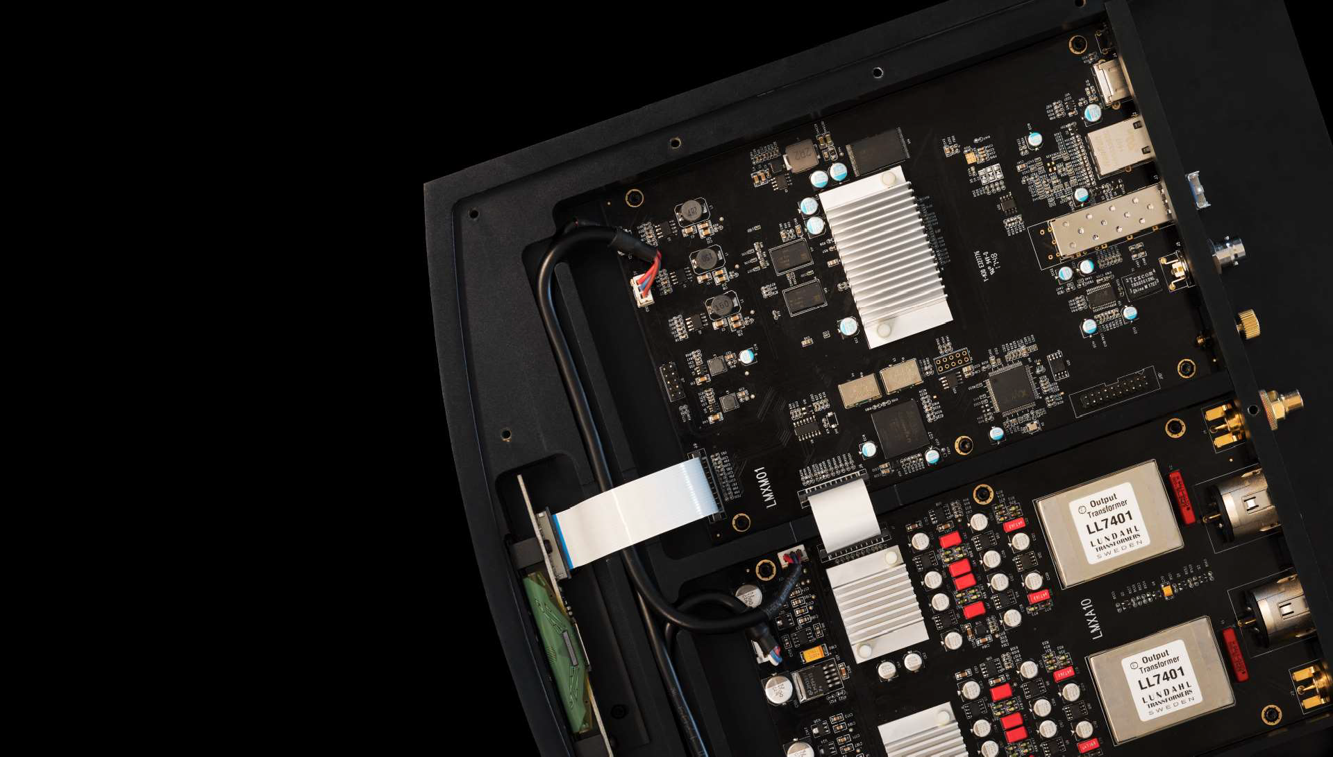

Slide 10
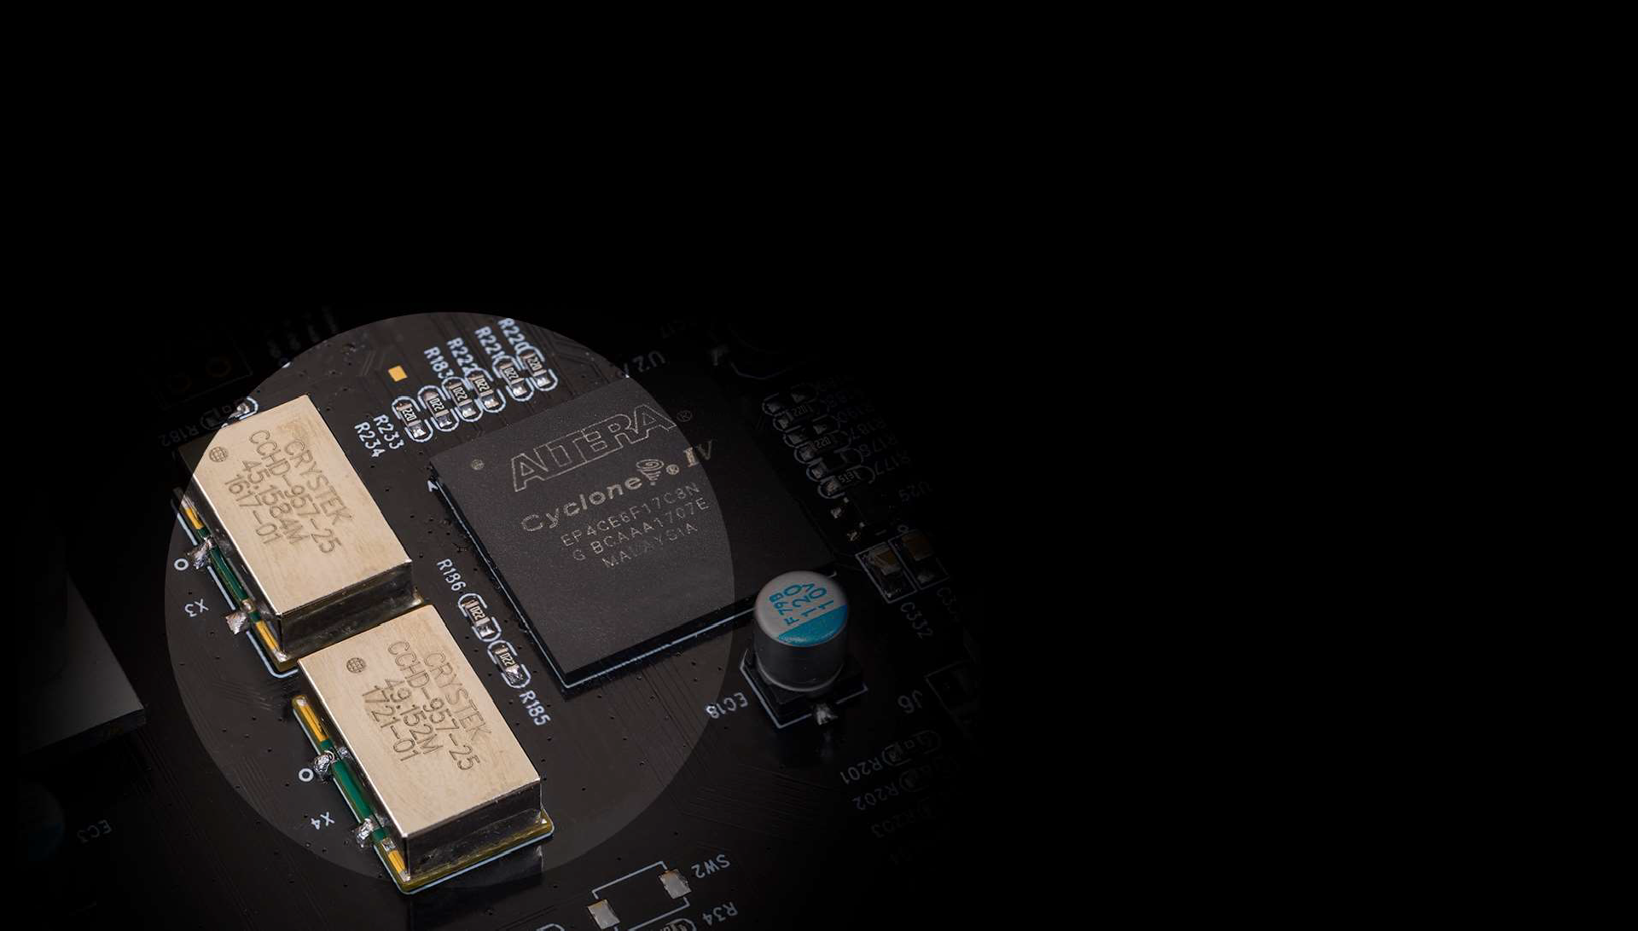

Slide 11
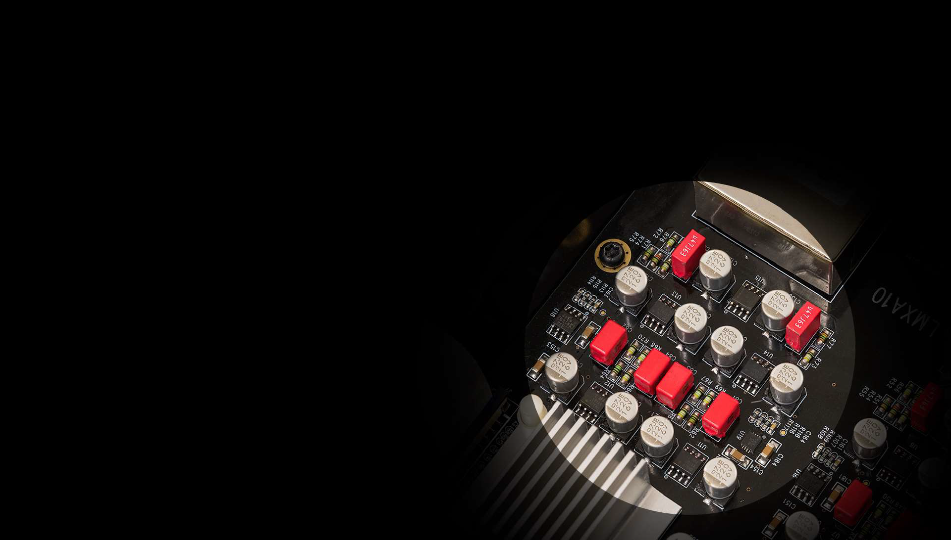

Slide 12
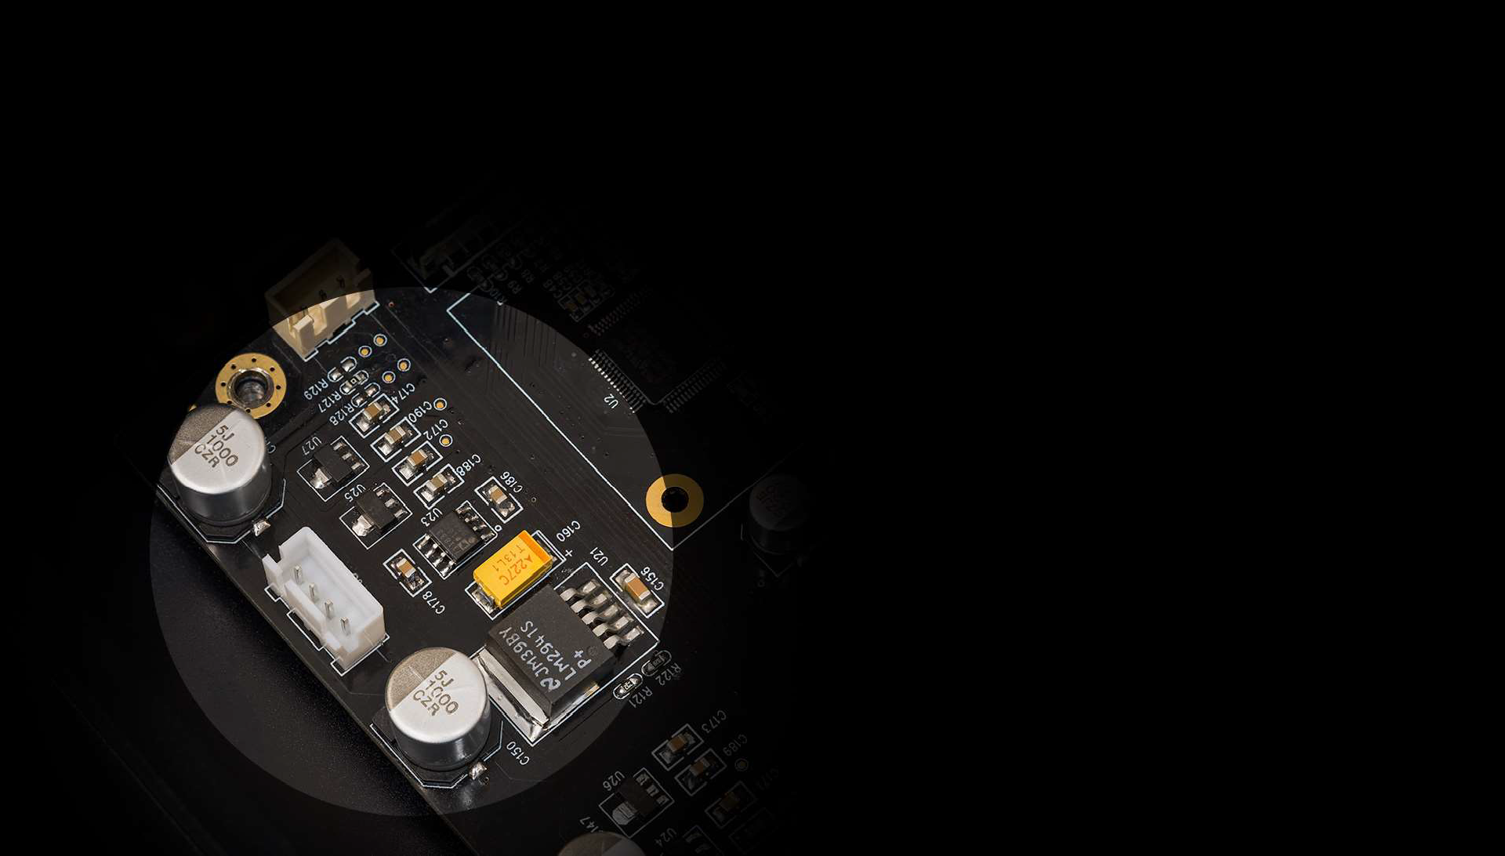

Slide 14
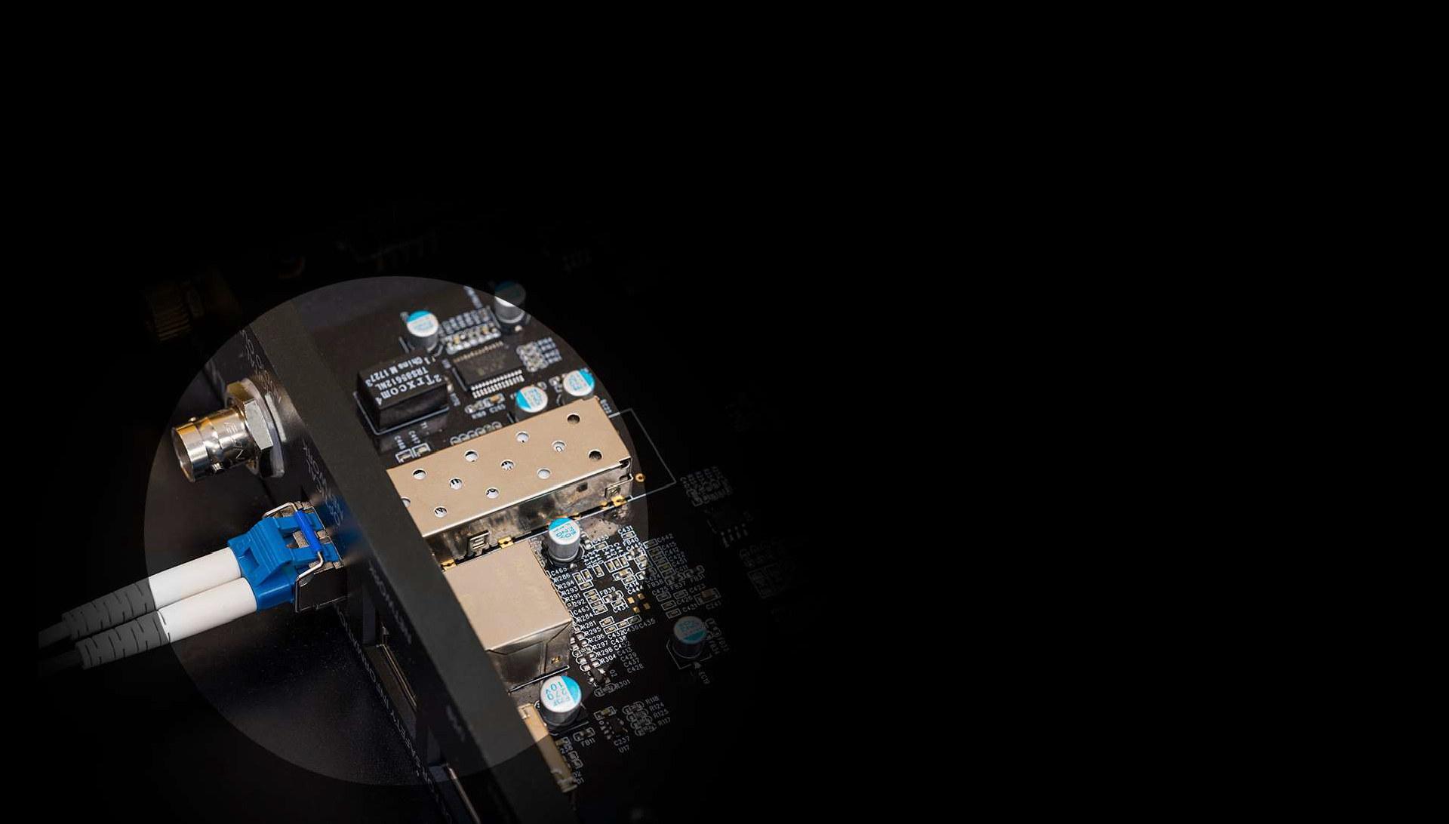

Slide 15
STREAMING PROTOCOL:
UPnP AV (OpenHome) protocol with audio streaming extension. Gapless Playback. On-device Playlist. Roon Ready
UPSAMPLING RATES & BIT DEPTHS:
PCM 384kHz and DSD128 upsampling
INPUT:
RJ45 Gigabit Ethernet Network (1000BASE-T)
SFP Gigabit Optical Ethernet Network
(1000BASE-T)
POWER SUPPLY:
External dual-toroidal PSU. CNC
SUPPORTED CONTROL DEVICES:
Apple iOS devices. iOS 5.0 or later required
Android devices. Android 4.0 (Ice Cream Sandwich) or later required
unit
Available in 220–240V AC and 110–120V AC versions ~ 50/60Hz
SUPPORTED AUDIO FILE FORMATS:
DSD :
DSF (DSD), DFF (DSD), DoP (DSD)
PCM:
FLAC, Apple Lossless (ALAC), WAV, AIFF
OTHER:
MQA, MP3, AAC (in M4A container)
(Single-partition FAT32, NTFS and EXT2/3 only)
OTHER:
Firmware Upgradable for further features and enhancements
APP FEATURES:
Volume control. High-resolution artwork. Artwork caching. Multiple-tag handling. ‘Composer’ tag support. Find. Automatic internet links to artists/album/songs.
Saving and restoring of playlists.
DIGITAL AUDIO OUTPUT:
USB:
DSD64/128/256/512 2.8-22.6MHz, 1-bit
Stereo
PCM 44.1–768kHz, 16-32-bit Stereo
COAXIAL BNC:
PCM 44.1khz– –24-bit
DSD (DoP, DSD over PCM) 2.8MHz, 1-bit
PHYSICAL:
LUMIN: 350mm (W), 345mm (D), 60mm (H),
8kg
PSU: 106mm (W), 334mm (D), 60mm (H),
4kg
SUPPORTED SAMPLE RATES & BIT DEPTHS:
PCM, 44.1khz–768kHz, 16–32-bit, Stereo DSD512, 22.6MHz, 1-bit, Stereo

